Slide 1
Successful Meetings

Slide 2

Over 11 million business meetings are held every day in the U.S.
Managers spend 30 to 70 percent of their time in meetings.
Most professionals attend around 62 meetings/month, with > 50% of these perceived as a waste of time.
A productive meeting of top managers costs thousands of dollars per hour; unproductive meetings cost more
One successful company banned meetings between 9 a.m. and 4 p.m.; others have a “meeting-free day” each week; others have stand up meetings. . .

Slide 3
Characteristics of Effective Meetings
Purpose and goals are set in advance
Appropriate people are attending
Agenda (with timeframes) is prepared and distributed in advance
Background information is distributed in advance; participatory assignments are made
Meeting is actively managed
Meeting ends with wrap-up, including action items and assignments
Written minutes are distributed promptly

Slide 4
The Top Five Reasons to Hold a Meeting
The interaction of opinions is necessary to create an idea, plan or project
Group dynamics are essential to the accomplishment of the purpose
Time restrictions limit other options
The subject is sufficiently complex as to require interaction and explanation
The boss/chair/organization says to hold a meeting

Slide 5
The importance of professionalism
Dress and act as a business consultant
Arrive early!
Dress for all capstone client meetings is business casual – capstone 1 and 2
Demonstrate respect
Address client formally unless they tell you otherwise, especially if “Dr.”
Be Prepared!

Slide 6
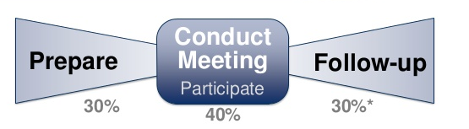
Bowtie Approach
It’s not just the meeting-
prep and follow-up are important
7 Ps of success

Slide 7
The Agenda is Critical
Agenda must include:
Topic for discussion
Presenter or discussion leader for each topic
Time allotment for each topic (ideally)
For each agenda item, indicate status (information, action, vote; or “for information, for discussion, for decision”)
Agenda needs the date, time and location – verify this in the email to your client. Include all participants. Phone number and email of all.
Send it out 3-5 days in advance

Slide 8

Managing the Meeting
START ON TIME, consistently!
Sends the message that time is valuable
Introduce attendees, if not already known
Manage time effectively
Keep on topic - Use ‘parking lot’ as needed.
Respect all opinions
Understand NEEDS versus WANTS
Don’t be afraid to use the whiteboard, recap, summarize, synthesize
Gather artifacts

Slide 9
What about items that are taking too long?
If new information is being presented and is critical, allow some leeway
If too long – parking lot
Tangential topics
Lengthy discussions
Not on agenda
Using the whiteboard regains control and focus

Slide 10
Roles: Meeting Leader
Conduct and control the meeting
Watch timing or assign someone to this
Ensure that all have an equal opportunity to speak
Adjudicate when and as necessary
Effect compromise on occasion
Close each item
Ensure action is clear
By whom and by when
Assign responsibility and “to dos”
Within team and to client

Slide 11
Members in General
Everyone has an equal say in the meeting
Share opinions, knowledge, questions
Ask clarifying questions
While the leader coordinates, everyone else is an active participant
Take notes - After the meeting, the team will discuss notes to help ensure consensus and clarity
Rotating meeting leadership gives everyone on the team the ability to develop these skills

Slide 12
Ending the Meeting
Spend 5-10 minutes summarizing key decisions/next steps
End on time
Shows respect for attendees

Slide 13
The Importance of Minutes
How essential was the meeting if it’s not worth recording?
Minutes will bring non-attendees up to speed, and remind attendees of directions taken
Good way to remind people of their assignments (action items)
Verifies understanding – and gives opportunity for additional or changed information
Include time/location of next meeting
Send to all attendees within 5 days

Slide 14
Action Items
Action Items must be part of the minutes
Used to highlight future action rather than past debate
Don’t record all the narrative, but record decisions and action items/tasks
Who does what and when

Slide 15
CD1
Remember – focus on the business process
Start general and get more specific
While you need to understand how they do things today, you will be improving their processes
No data – but artifacts
Not concerned with number of users or access levels
You are the BUSINESS ANALYST – you need to focus first on their business

Slide 16
Vacation Planning
You just won a $1000 vacation voucher that you can use anywhere you want but you can not travel to a place you have been to.
Take 5 minutes to plan and write down your vacation

Slide 17
Vacation Planning Analysis
How did you approach going on vacation?
Did you start with “I will Fly” or “I will Drive”…these are ways to get there
Most likely started with:
Deciding what you want to get out of the trip
Deciding where to go
Deciding when to go
Then, decide how to go
Requirements gathering works the same way.

Slide 18
Sample Agenda & Meeting Minutes

Slide 19
Flow of the Meeting
Begin on time – get there early
Leader welcomes everyone and thanks them for their commitment to the project
Review how you want to conduct the meeting
Review the agenda
Discuss the goals of the meeting
Using minutes from the previous meeting, each person reports on previous commitments
Use the remaining time to discuss new items and review documents for feedback
Make sure each participant has a voice
Go through the task list
Document all commitments and action items
Review and reconfirm
Summarize each person’s commitments using WHO, WHAT and WHEN.
Leader reconfirms the next scheduled meeting
End on time or early.

Slide 20
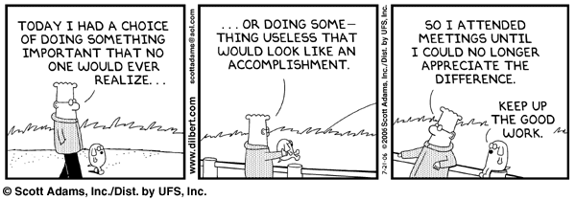
And a word from Dilbert

